Slide 1
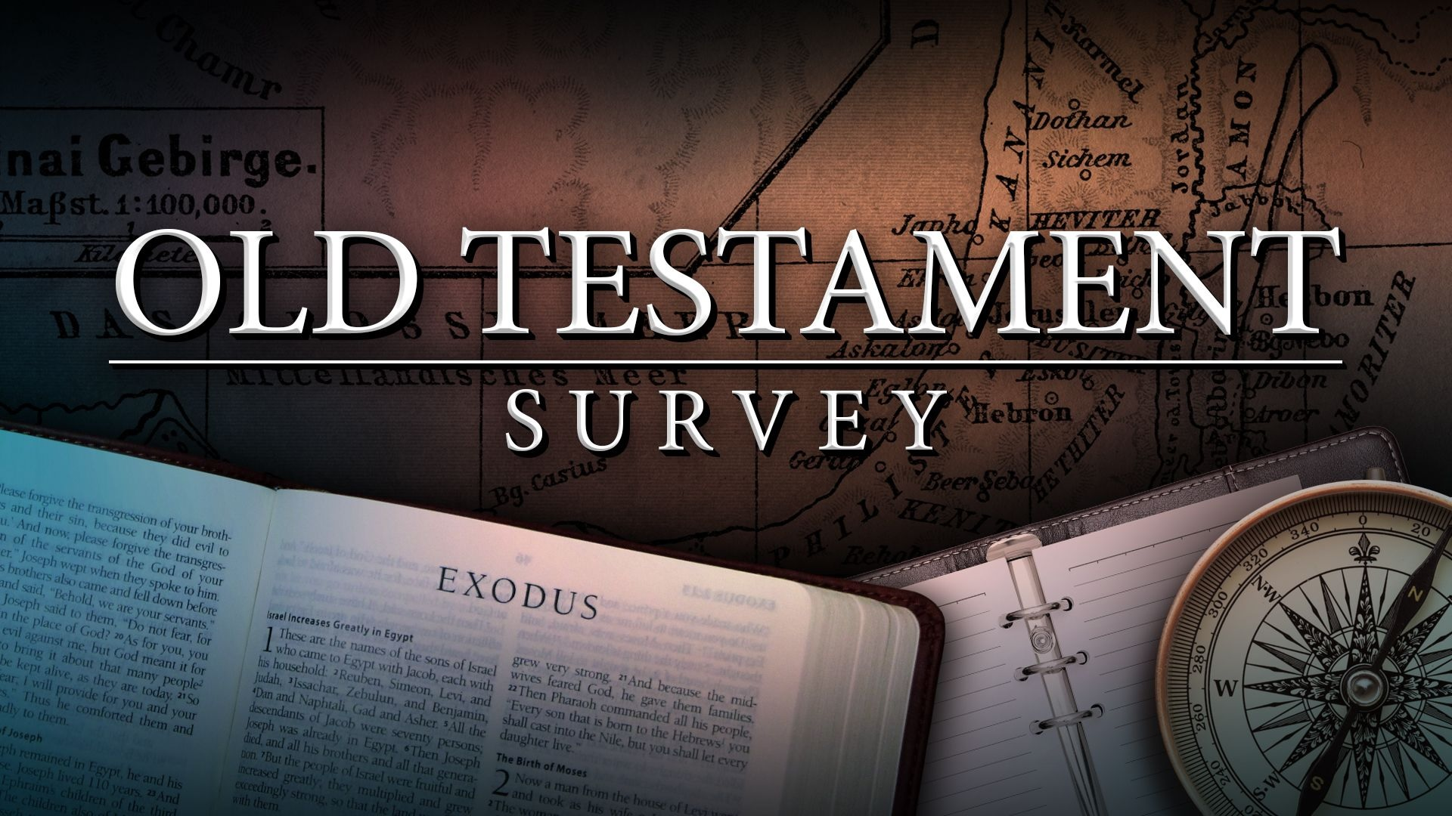
Southeast Georgia
School of the Bible
Lesson 10

Slide 2
Genesis
The Book of Beginnings
Four Great Events - 4 C’s
Creation/Curse/Catastrophe/Coalition
Four Great Men Abraham/Isaac/Jacob/Joseph
Genesis 1:1
“In the beginning God created the heaven and the earth.”

Slide 3
Exodus
The Book of Redemption
Exodus 6:6
Wherefore say unto the children of Israel, I am the LORD, and I will bring you out from under the burdens of the Egyptians, and I will rid you out of their bondage, and I will redeem you with a stretched out arm, and with great judgments:

Slide 4
Leviticus
The Book of Atonement
5 Major Offerings
“B-M-P-S-T”
Burnt – Redemption
Meat – Propitiation
Peace – Reconciliation
Sin – Justification
Trespass – Regeneration
Leviticus 16:34
And this shall be an everlasting statute unto you, to make an atonement for the children of Israel for all their sins once a year. And he did as the LORD commanded Moses.
7 Major Feasts
“P-U-F-P-T-A-T”
  1-Passover
  2-Unleavened Bread
  3-Firstfruits
  4-Pentecost
  5-Trumpets
  6-Atonement
  7-Tabernacles

Slide 5
Numbers
The Book of Wanderings
Numbers 33:1
These are the journeys of the children of Israel, which went forth out of the land of Egypt with their armies under the hand of Moses and Aaron.
"Numbering" of the people
Men Numbered - 20 yrs. old & above
Not Numbered - Levites, women, & children under 20 yrs. old

Slide 6
Deuteronomy
The Book of Remembrance
Deuteronomy 15:15
And thou shalt remember that thou wast a bondman in the land of Egypt, and the LORD thy God redeemed thee: therefore I command thee this thing to day.
Pivotal Passage
Deuteronomy 6:4-5
Hear, O Israel: The LORD our God is one LORD: And thou shalt love the LORD thy God with all thine heart, and with all thy soul, and with all thy might.

Slide 7
Joshua
The Book of Victory
Joshua 1:8
This book of the law shall not depart out of thy mouth; but thou shalt meditate therein day and night, that thou mayest observe to do according to all that is written therein: for then thou shalt make thy way prosperous, and then thou shalt have good success.

Slide 8
Judges
The Book of Apostasy, Defeat, and Deliverance
Judges 17:6
In those days there was no king in Israel, but every man did that which was right in his own eyes.

Slide 9
Ruth
The Book of Redeeming Grace
-The Kinsman-Redeemer-
Ruth 4:14
And the women said unto Naomi, Blessed be the LORD, which hath not left thee this day without a kinsman, that his name may be famous in Israel.
Elimelech / Naomi / Ruth / Orpah / Mahlon / Chilion

Slide 10
1st Samuel
The Book Of Rejection
(Israel’s 1st King – Saul)
1 Samuel 8:7
And the LORD said unto Samuel, Hearken unto the voice of the people in all that they say unto thee: for they have not rejected thee, but they have rejected me, that I should not reign over them.

Slide 11
2nd Samuel
The Book of
Triumphs & Troubles
(Israel’s 2nd King – David)
2 Samuel 5:4-5
David was thirty years old When he began to reign, and he reigned forty years. In Hebron he reigned over Judah seven years and six months: and in Jerusalem he reigned thirty and three years over all Israel and Judah.

Slide 12
1st Kings
The Book of
The Divided Kingdom
1 Kings 2: 12
Then sat Solomon upon the throne of David his father; and his kingdom was established greatly.

Slide 13
2nd Kings
The Book of
Kingdom Captivity
Israel—Assyrians
Judah—Babylonians
2 Kings 23: 27
And the LORD said, I will remove Judah also out of my sight, as I have removed Israel, and will cast off this city Jerusalem which I have chosen, and the house of which I said, My name shall be there.

Slide 14
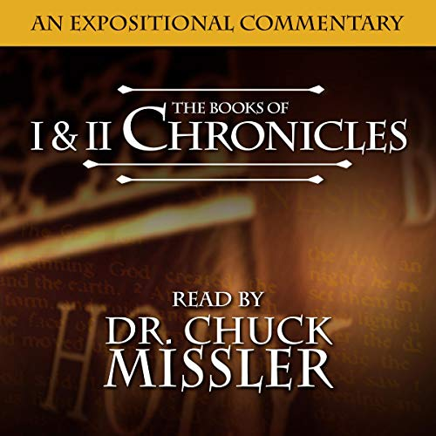
Lesson 10

Slide 15
Lesson 10
1stChronicles
The Book of Highlights of David’s Life
2ndChronicles
Solomon & His Successors

Slide 16
Handout #10
1 & 2 Chronicles
1 Chronicles
Author:
It is likely that Ezra is the human author
It is possible that 1, 2 Chronicles and Ezra were originally one continuing history- 2 Chronicles 36: 22-23 and Ezra 1:1-3
Date:
Written between 450-425 B.C. after Ezra led a remnant back from captivity
The events covered parallel the book of 2 Samuel
Theme: “GOD’S COVENANT REMAINS”°(See 17:7-15)
The Jews were taken captive, now a new generation is returning to Jerusalem. The city is in ruins and the Davidic throne is gone, but God’s covenant to Israel still stands!
  Looking back — Israel had a great heritage
  Looking forward — Israel had God’s promises
  In the present — Israel had the presence of Jehovah; He was truly their king (29:1 l-12)

Slide 17
Handout #10
1 & 2 Chronicles
1 Chronicles
Outline:
Israel’s Main Genealogies (Ch. 1-9)
David’s Reign at Jerusalem (Ch. 10-29)
Key Words: “reigned” “build thee an house”
Key Verse: 1 Chronicles 17:9 - “Also I will ordain a place for my people Israel, and will plant them, and they shall dwell in their place, and shall be moved no more; neither shall the children of wickedness waste them any more, as at the beginning.”
Special Features:
  Genealogies — (Ch. 1-9)
    In the destruction of Judah by Babylon, many family records had been destroyed.
    These genealogies trace the sacred line through which God’s covenant was transmitted for nearly 3,500 years!

Slide 18
  The Perspective of Chronicles differs from that of Samuel/Kings.
Samuel & Kings | Chronicles
Prophetic View (judgment) | Priestly View (hope)
The Throne | The Temple
Both Israel & Judah | Primarily Judah
The kings | The Davidic line
Political | Ecclesiastical
Comprehensive | Selective
Christ In The Book:
The promises of the Davidic Covenant fulfilled in the Person of Christ, the “Son of David” (Matt. 1:1)
A Kingdom forever ( 17:4)
A Throne forever (17:l2,14)

Slide 19
Handout #10
1 & 2 Chronicles
11/11/19
2 Chronicles
Author:
Ezra — continuing to Write to a returned remnant
Date:
435-400 B.C. — after the exile
Events covered parallel 1 and 2 Kings
Theme: “What You Do With God Determines What God Will Do With You!”
This is the story of Solomon and the kings of Judah — when they followed the Lord, He fought for them; when they went after other gods, they suffered defeat.
This is seen clearly in 2 Chronicles 7:14-22 and 15:1-4
God’s part Man’s part

Slide 20
Handout #10
1 & 2 Chronicles
11/11/19
2 Chronicles
Outline:
Solomon’s Forty-year Reign (Ch. 1-9)
Judah’s History to the Exile (Ch. 10-36)
Key Words: “Established” “Seek the Lord”
Key Verse: 2 Chronicles 7:14 - “If my people, which are called by my name, shall humble themselves, and pray and seek my lace, and turn from their wicked ways; then will I hear from heaven, and will forgive their sin, and will heal their land.”
Special Features:
  An emphasis is laid on the godly kings of Judah who led in spiritual reform:
    Asa, Jehoshaphat, Joash, Hezekiah, Josiah

Slide 21
Handout #10
1 & 2 Chronicles
11/11/19
2 Chronicles
  The Chronicles serves as the true link between the Pre-exile period and Post-exile period.
    Chronicles — Retrospection of the history of God’s people
    Ezra — Restoration of the Temple
    Nehemiah — Reconstruction of the Walls of Jerusalem
    Esther — Preservation of the Jews in Dispersion
Christ In The Book:
He is our Captain (13:12)
  He is the one Who fights our battles.
He is the One in control of Kings & kingdoms — (36:22-23)

Slide 22
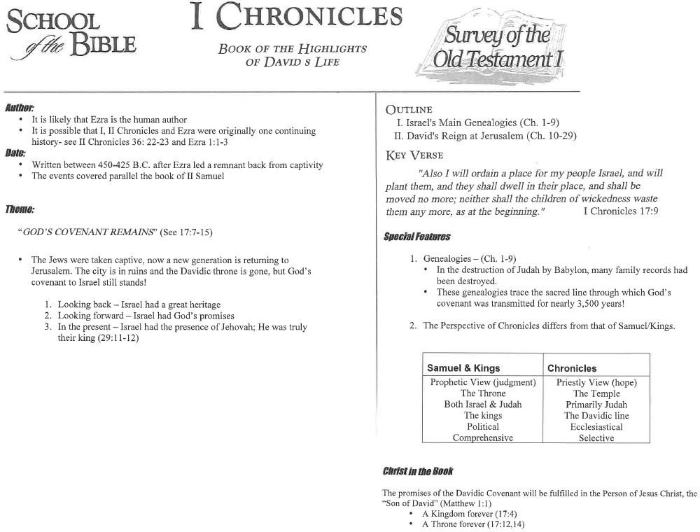
Handout #10
1 & 2 Chronicles
11/11/19

Slide 23
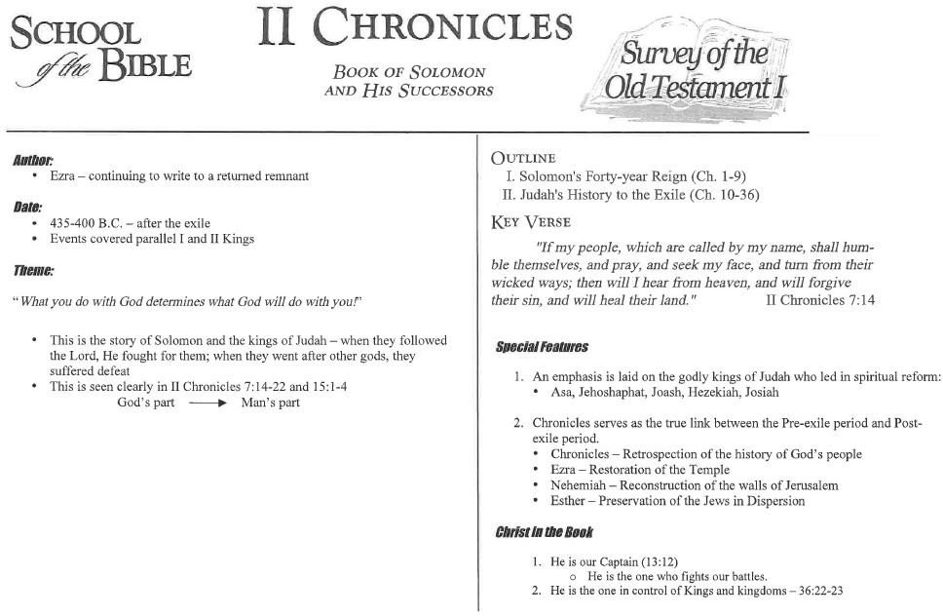
Handout #10
1 & 2 Chronicles
11/11/19

