Slide 1
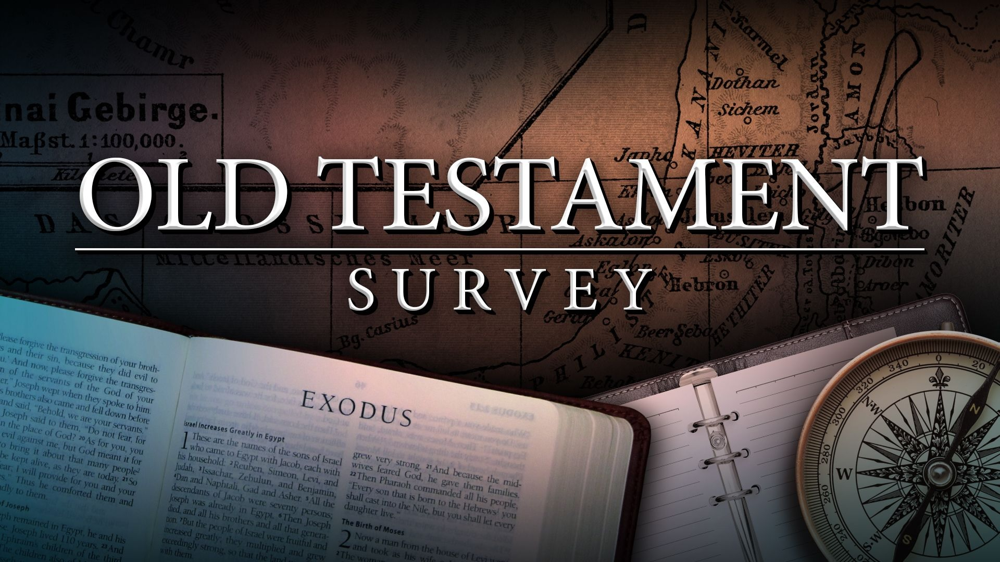
Southeast Georgia
School of the Bible
Lesson 11

Slide 2
Genesis
The Book of Beginnings
Four Great Events - 4 C’s
Creation/Curse/Catastrophe/Coalition
Four Great Men Abraham/Isaac/Jacob/Joseph
Genesis 1:1
“In the beginning God created the heaven and the earth.”

Slide 3
Exodus
The Book of Redemption
Exodus 6:6
Wherefore say unto the children of Israel, I am the LORD, and I will bring you out from under the burdens of the Egyptians, and I will rid you out of their bondage, and I will redeem you with a stretched out arm, and with great judgments:

Slide 4
Leviticus
The Book of Atonement
5 Major Offerings
“B-M-P-S-T”
Burnt
Meat
Peace
Sin
Trespass
Leviticus 16:34
And this shall be an everlasting statute unto you, to make an atonement for the children of Israel for all their sins once a year. And he did as the LORD commanded Moses.
7 Major Feasts
“P-U-F-P-T-A-T”
  1-Passover
  2-Unleavened Bread
  3-Firstfruits
  4-Pentecost
  5-Trumpets
  6-Atonement
  7-Tabernacles

Slide 5
Numbers
The Book of Wanderings
Numbers 33:1
These are the journeys of the children of Israel, which went forth out of the land of Egypt with their armies under the hand of Moses and Aaron.
"Numbering" of the people
Men Numbered - 20 yrs. old & above
Not Numbered - Levites, women, & children under 20 yrs. old

Slide 6
Deuteronomy
The Book of Remembrance
Deuteronomy 15:15
And thou shalt remember that thou wast a bondman in the land of Egypt, and the LORD thy God redeemed thee: therefore I command thee this thing to day.
Pivotal Passage
Deuteronomy 6:4-5
Hear, O Israel: The LORD our God is one LORD: And thou shalt love the LORD thy God with all thine heart, and with all thy soul, and with all thy might.

Slide 7
Joshua
The Book of Victory
Joshua 1:8
This book of the law shall not depart out of thy mouth; but thou shalt meditate therein day and night, that thou mayest observe to do according to all that is written therein: for then thou shalt make thy way prosperous, and then thou shalt have good success.

Slide 8
Judges
The Book of Apostasy, Defeat, and Deliverance
Judges 17:6
In those days there was no king in Israel, but every man did that which was right in his own eyes.

Slide 9
Ruth
The Book of Redeeming Grace
-The Kinsman-Redeemer-
Ruth 4:14
And the women said unto Naomi, Blessed be the LORD, which hath not left thee this day without a kinsman, that his name may be famous in Israel.
5 Main Characters
Elimelech / Naomi / Ruth / Orpah / Mahlon / Chilion

Slide 10
1st Samuel
The Book Of Rejection
(Israel’s 1st King – Saul)
1 Samuel 8:7
And the LORD said unto Samuel, Hearken unto the voice of the people in all that they say unto thee: for they have not rejected thee, but they have rejected me, that I should not reign over them.

Slide 11
2nd Samuel
The Book of
Triumphs & Troubles
(Israel’s 2nd King – David)
2 Samuel 5:4-5
David was thirty years old When he began to reign, and he reigned forty years. In Hebron he reigned over Judah seven years and six months: and in Jerusalem he reigned thirty and three years over all Israel and Judah.

Slide 12
1st Kings
The Book of
The Divided Kingdom
1 Kings 2: 12
Then sat Solomon upon the throne of David his father; and his kingdom was established greatly.

Slide 13
2nd Kings
The Book of
Kingdom Captivity
Israel—Assyrians
Judah—Babylonians
2 Kings 23: 27
And the LORD said, I will remove Judah also out of my sight, as I have removed Israel, and will cast off this city Jerusalem which I have chosen, and the house of which I said, My name shall be there.

Slide 14
1stChronicles
Highlights of David’s Life
2ndChronicles
Solomon & His Successors
1 Chronicles 17:9
Also I will ordain a place for my people Israel, and will plant them, and they shall dwell in their place, and shall be moved no more; neither shall the children of wickedness waste them any more, as at the beginning,
2 Chronicles 7:14
If my people, which are called by my name, shall humble themselves, and pray, and seek my face, and turn from their wicked ways; then will I hear from heaven, and will forgive their sin, and will heal their land.

Slide 15
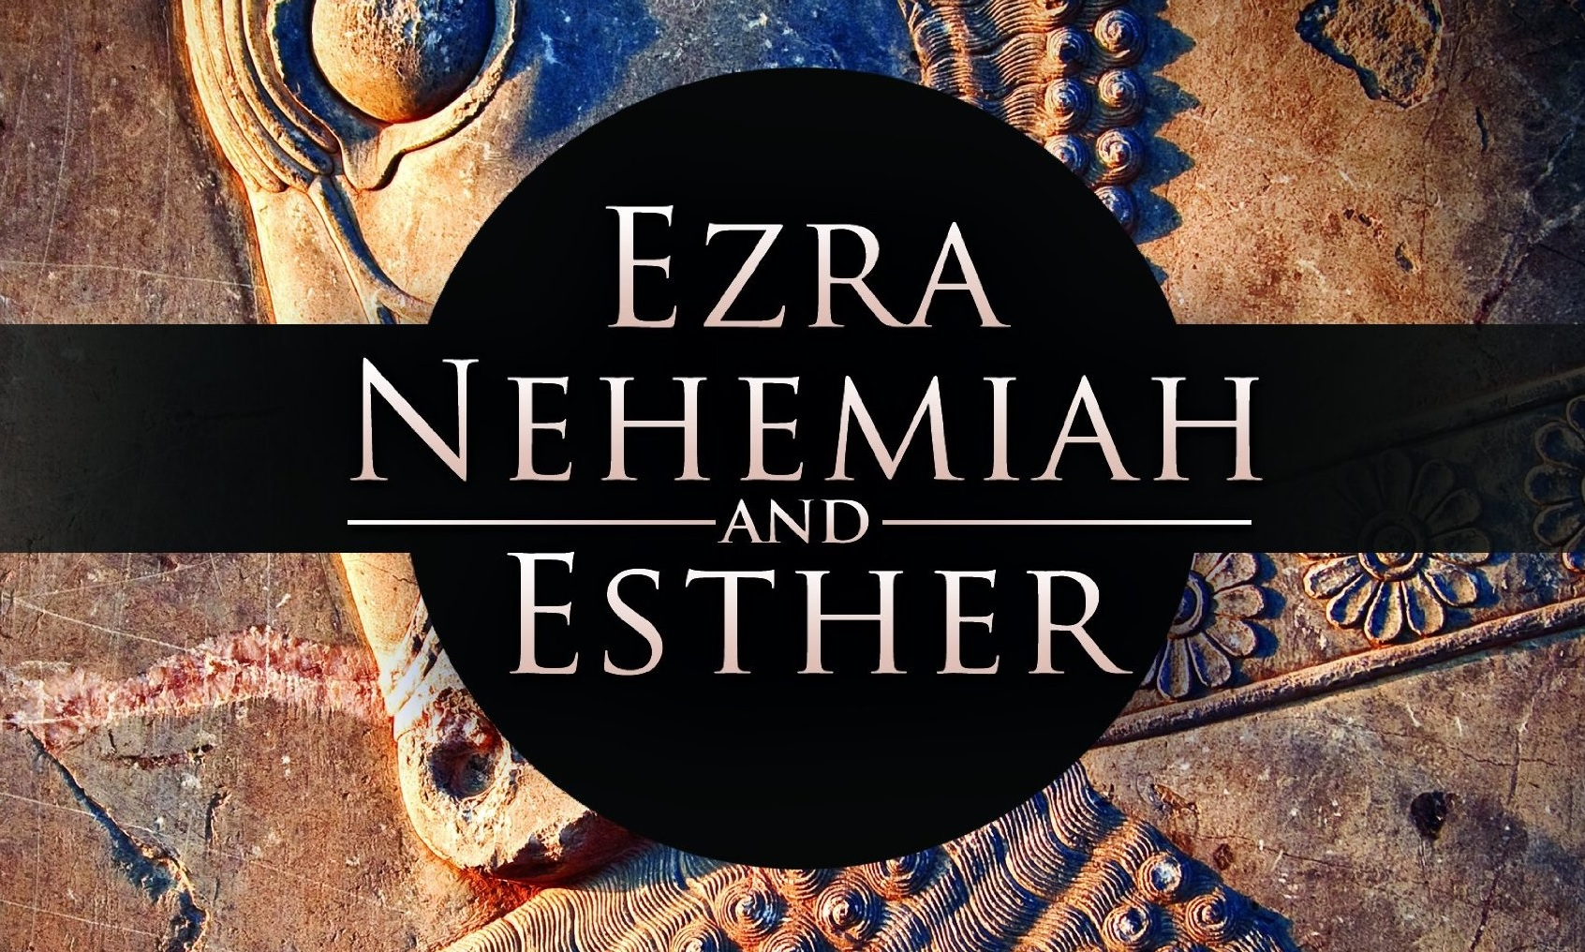
Lesson 11

Slide 16
Lesson 11
Ezra
The Book of Return & Restoration
Nehemiah
The Book of Rebuilding
Esther
The Book of Providential Care

Slide 17
Two Exiles
Israel (10 Tribes)-722 B.C. - Assyrian
Judah (2 Tribes)-586 B.C. - Babylonian
Three Deportations (Judah)
BABYLON
Nebuchadnezzar
Court (Daniel)… 606 B.C.
Craftsmen (Ezekiel)… 597 B.C.
COMMON (The Rest of them) … 586 B.C.
70
Years
Three Returns (Judah)
PERSIA
Cyrus the Great
Darius I
Xerxes
Artaxerxes I
Zerubbabel (50,000 of Judah)… 536 B.C.
Ezra (2,000 Priests & Levites)… 458 B.C.
Nehemiah … 444 B.C.

Slide 18
Ezra
Nehemiah
Ch. 1-2 Return
Ch. 3-6 Rebuild
Ch. 7-8 RENEW
Ch. 9-10 Reform
Ch. 1-2 Return
Ch. 3-6 Rebuild
Ch. 7-8 ReNEW
Ch. 9-10 Reform
Ch. 9
A Prayer of Confession

Slide 19
Ezra / Nehemiah / Esther
The Book of Ezra
Author:
Ezra — “the Lord helps”
Ezra was primarily a religious leader, not a political or military leader
Ezra is called a “ready scribe”—(an interpreter and teacher of OT Scriptures)-(Ezra 7: 1-6)
Date:
After 456 B.C.
There were THREE “returns” of Jews from Babylonian captivity:
Theme: “THE RETURNING REMNANT”
The book of Ezra covers the first two retums of the remnant from captivity in Babylon:
1st Return —about 50,000 Jews returned
Leader: Zerubbabel — he was a political leader, a governor, yet he was obviously a spiritual man; he led in the rebuilding of the temple of the Lord in Jerusalem
2nd Return —about 2,000 Jews returned
Leader: Ezra — he was primarily a religious leader; he re-established temple worship
The remnant, though they had been raised in Babylon, were compelled to return to the place of blessing and the to place of worship.
God used a heathen king, Cyrus (1 : 1-4), to make a way for these Jews to return.

Slide 20
Ezra / Nehemiah / Esther
The Book of Ezra
Outline:
The Return under Zerubbabel (ch. 1-6)
Main Accomplishment - the Temple was rebuilt
The Return Under Ezra (ch. 7-10)
Main Accomplishment — People re-separated
Key Words: “Build” “Hand of the Lord”
Key Verse: Ezra 7: 10 - “For Ezra had prepared his heart to seek the law of the LORD, and to do it, and to teach in Israel statutes and judgments. ”

Slide 21
The Book of Ezra
Special Features:
  This remnant returned in direct fulﬁllment of prophecy. God kept His Word! [Isaiah 44:24-45:3 Jeremiah 25:8-11, 29:14]
  God used the prophets Haggai and Zechariah to stir the people to rebuild the Temple during Zerubbabel’s day
  Esther ﬁts between Ezra Ch. 6 and Ch. 7 — (a 60-year gap)
Christ In The Book:
Cyrus — called God’s anointed, pictures Christ (Isa. 45:1)
    He was the conqueror of Israel’s enemy
    He was the restorer of the Holy City
    He gloriﬁed the name of God

Slide 22
Ezra / Nehemiah / Esther
The Book of Nehemiah
Author:
Nehemiah - "comforted of God"
The King's cupbearer in Shushan the palace; this was a respected position
His heart was stirred as he prayed for his people (Ch. 1)
Date:
Written about 432 B.C.
This book covers a period of 12-15 years.
Theme: "OPPORTUNITY & OPPOSITION"
In 444 B.C., Nehemiah led the 3rd "return" of the remnant, just a handful of people)
He accomplished two things:
He re-built the walls of the city of Jerusalem (in 52 days - 6:15)
He reconsecrated the people to the Lord and re-instructed them in the law of God.{8:1-9; 9:1-3)

Slide 23
Ezra / Nehemiah / Esther
Outline:
The Reconstruction of the Wall (Ch. 1-6)
The Reinstructing ofthe People (Ch. 7-13)
Key Words: "Work"
Key Verse: Nehemiah 6:3 - "And I sent messengers unto them, saying, I am doing a great work, so that I cannot come down: why should the work cease, whilst I leave it, and come down."
Special Features:
  The prophet Malachi ministered during Nehemiah's day.
  Nehemiah provides an example of godly leadership.
    He was a man of prayer.
    He was a man of faith.
    He was a man of courage.
    He was a man of hard work.
Christ In The Book:
Nehemiah is a picture of Christ:
He have up a high position to identify with his people
He came with a mission of restoration
He was a man of compassion
His work was finished - he didn't come down

Slide 24
The Book of Esther
Author:
The author is unknown, but it was likely a Jew living in Persia (perhaps Mordecai).
Date: Written about 450 B.C
Covers 12-20 years when Ahaseurus (XERXES) was King of Persia
Theme: "GOD IS ALWAYS AT WORK"
The book of Esther is the Romans 8:2 of the O.T.
This book reveals two great truths:
  God cared for the remaining Jews just as mllch as he cared for the returning Jews.
  God is always present, even when His name is not!
  (God's name is not mentioned in this book,
  yet He is certainly working!)
Outline: "God In The Shadows Watches His Own"
Crisis Anticipated (Ch. 1-5)
Crisis Overruled (Ch. 6-10)

Slide 25
Esther
Key Word: "Deliverance"
Key Verse: Esther 4:14 • "For if thou altogether holdest thy peace at this time, then shall there enlargement and deliverance arise to the Jews from another place; but thou and thy father's house shall be destroyed: and who knoweth whether thou art come to the kingdom for such a time as this?"
Special Features:
  This story fits between Ezra Ch. 6 and Ch. 7
  Main characters in this story:
King Ahaseurus
Vashti
Esther
Mordecai
Haman
  In this book, we learn about the Providence of God:
  God places
God provides
God protects
God prevents
God preserves

Slide 26
Ezra / Nehemiah / Esther
Christ In The Book:
    Mordecai pictures Christ - he was despised, but finally received a place of honor
    Esther pictures Christ - she put herself in the place of death for her people; she was an advocate

Slide 27
Southeast Georgia
School of the Bible
End of
Lesson 11

