Slide 1
Handout #12
The Poetic Books & Job
The Poetic Books of the Bible
The Five Books of Poetry:
Job - the secrets of suffering
Psalms - the secret of worship
Proverbs - the secrets of happiness
Ecclesiastes - vanity of vanities
Song of Solomon - the secrets of love
The past 17 books dealt with a nation....The 5 books of poetry deal with the human heart.
Job:
The purpose of Job reveals the need to exercise faith when we don't know the reasons for suffering and affliction.
Job was faithful though he had no Bible.
Job is thought to be the oldest book in the Bible. Job contains 42 chapters.
James 5:11 sates "Ye have heard of the patience of Job."
Job loses his wealth, children, and health yet still remains faithful to God. God never explains to Job why he suffered.
God gave Job twice as much in the end as he had before.
Psalms:
Psalms contains 150 chapters.
Psalms means a sacred song or poem.
Psalms was set to music for the tabernacle and temple worship. Psalms contains the two middle words of the Bible "The Lord". David is the main Author of Psalms.
Psalms is the most quoted book of the New Testament. 1st Century Christians sang the Psalms.
The book of Psalms has five major divisions ending with the word amen. Psalm 22 deals with the suffering savior or cross. The Good Shepherd
Psalms 23 deals with the Living savior. The Great Shepherd
Psalms 24 deals with the exalted kind or crown. The Chief Shepherd
Selah means Pause.
Psalms we studied included 1, 8, 19, 23, 100, 119.

Slide 2
Handout #12
Proverbs:
The Poetic Books & Job
1/13/2020
1/13/2020
Proverbs deals with Practical wisdom and Proverbs will develop your character. A Proverb is a short popular saying that expresses some obvious Truth.
Solomon is the man Author of Proverbs.
Solomon spake 3000..... 1 Kings 4:32 And he spake three thousand proverbs: and his songs were a thousand and five.
Proverbs 31 describes a virtuous woman.
Ecclesiastes:
Solomon is the author of Ecclesiastes. He calls himself the Preacher.
Ecclesiastes teaches the emptiness of everything apart from God. The key word in Ecclesiastes in vanity.
The problem with man is that he is looking “under the sun” instead of looking to the “SON” of God.
Ecclesiastes teaches the greater the enjoyment the greater the disappointment. Ecclesiastes teaches that only God can satisfy.
In Ecclesiastes the World is the object.
Song of Solomon:
In Song of Solomon Jesus Christ is the object. Solomon wrote 1005 songs. (1 Kings 4:32)
Another name for the Song of Solomon is Canticles which means song or chant. The key word in Song of Solomon is Love.
There are two unique names of Jesus in the Song of Solomon:
1.
2.
The Rose of Sharon
The Lily of the Valleys
The unique name of the groom's bride is Shulamite (6:13)
The Jews refer to the Song of Solomon as the Holy of Holies of Scripture.
Orthodox Jews required you to be 30 years of age before you could read the Song of Solomon.

Slide 3
Handout #12
The Poetic Books & Job
1/13/2020

Slide 4
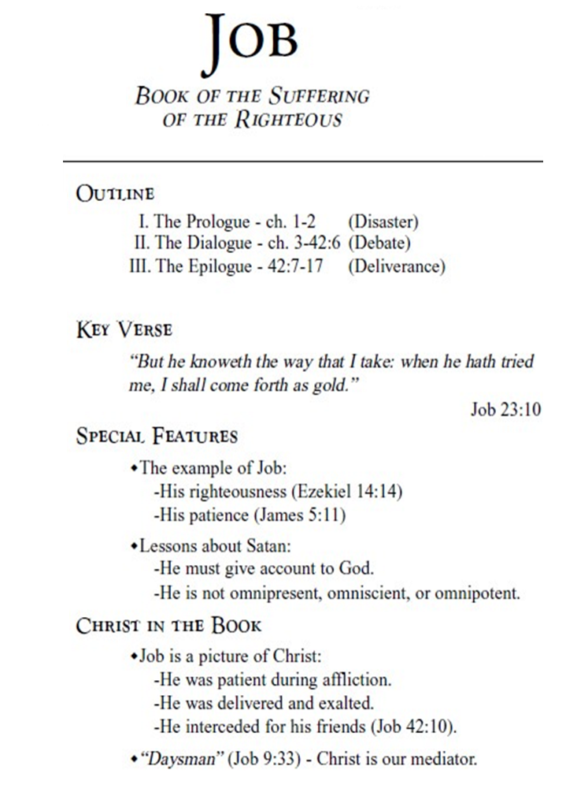
Handout #12

