Slide 2
Southeast Georgia School of the Bible

Slide 3
Introduction to the Old Testament

Slide 4
The Bible… A Book of Books
Old Testament… 39 Books… (5-12-5-5-12)
5 Books of Moses…The Law… The Torah…The Pentateuch
12 Books of History… Joshua – Esther
5 Books of Poetry… Job – Song of Solomon
5 Major Prophets… Isaiah – Daniel
12 Minor Prophets… Hosea – Malachi
New Testament… 27 Books
Gospels (4)
Acts (1)… History
Paul’s Epistles (14)
General Epistles (7)
James
1st and 2nd Peter
1st , 2nd , 3rd John
Jude
Revelation (1)… Prophecy

Slide 5
God gave us a BOOK of BOOKS… -A LIBRARY of BOOKS-
NOT JUST…
Topics
Texts
Chapters
Verses
Words
They are all there, but He gave them to us in BOOKS!

Slide 7
God gave us the Bible… -In TIME and SPACE-
WHEN …and… WHERE
Chapters & Verses & Words – Yes
But in TEXTS & CONTEXTS
Understanding TIME & SPACE (place) will UNLOCK the Bible for you…
The Bible has both…
HISTORY (when) & GEOGRAPHY (where)

Slide 8
5
12
5
5
12
The Torah
The Law
The Law of Moses
All 5 books written by Moses

Slide 9
One of the Most Ignored Parts of Your Bible

Slide 10
The Fertile Crescent

Slide 11
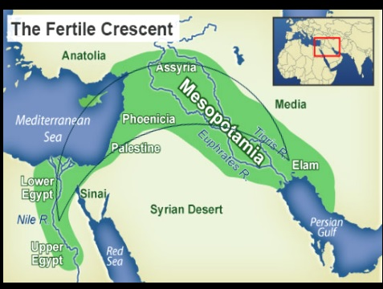

Slide 12
Old “Testament”
The word means “covenant,” referring to an agreement between men or between God and men.
As far as the Bible is concerned, the Old Testament is the record of the Old Covenant, the covenant God made with the Jews at Mt. Sinai; and the New Testament is the record of the New Covenant that Christ made through His blood.

Slide 13
I. The Revelation of the Old Testament Scriptures
A. Its Purpose
The Bible is the written revelation of God.
It is not merely about people and events but about the true and living God Himself.
B. Its Overview
Written by over 30 human authors during a period of some 1,200 years.
Makes up approx. 2/3 of the Bible.
Covers 4,000 years of history
Contains more than 300 specific prophecies of Jesus Christ.

Slide 18
II. The Reasons for Studying the Old Testament Scriptures
It provides the background for Christ’s work.
It reveals eternal principles that never change
It foretells future events that are fulfilled in the NT.
It provides amplified commentary on NT passages.
It gives a detailed history of the nation of Israel.
It reveals the heart of our God.

Slide 19
III. The Relationship Between the Old and New Testaments
A. The Bible is one Book, yet it naturally divides itself into the Old (former) Testament (“covenant”) and the New Testament.
B. We find truths in the OT in seed form; we find the same truths in the NT in fully-developed form.
C. The OT and NT complete one another.
D. The OT is a broad base upon which the NT builds.

Slide 20
The Lord Jesus Christ
As you journey thru this progressive revelation, the focal point narrows to the Person of Jesus Christ (Hebrews 1:1-3)
New
Testament
Old
Testament

Slide 21
End of Lesson 1

