Slide 1
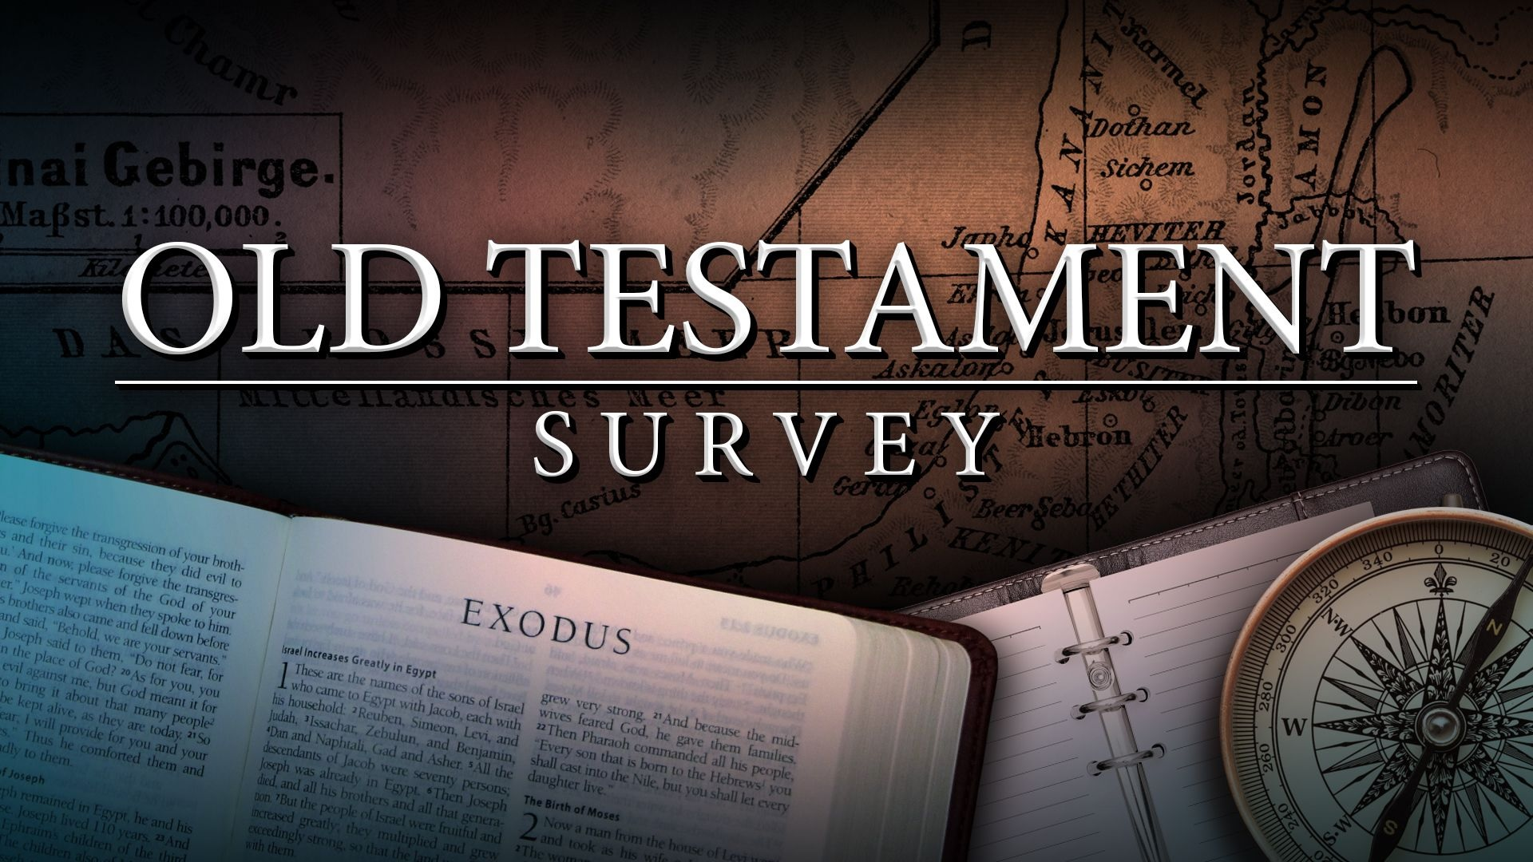
Southeast Georgia
School of the Bible
Lesson 5

Slide 2
A Quick Review of Genesis
Genesis means “beginnings” and is the seed plot of the Bible.
Genesis was written by Moses and Chapters 1-11 cover 2,000 years of history.
Four Great Events - 4 C’s
Creation/Curse/Catastrophe/Coalition
Four Great Men Abraham/Isaac/Jacob/Joseph

Slide 3
A Quick Review of Exodus
Exodus means
“exit” or “the way out”.
Author: Moses
Theme: REDEMPTION

Slide 4
Key Chapters of Exodus
Ch. 1-A Pharaoh arose who "knew not Joseph"
Ch. 2-The Birth of Moses
Ch. 3-The Call of Moses… at the Burning Bush
Ch. 4-12-THE 10 PLAGUES
Ch. 12-13-A Lamb… The Lamb… Your Lamb
Ch. 14-Crossing the Red Sea
Ch. 20-THE 10 COMMANDMENTS
Ch. 25-40-The Tabernacle

Slide 5
A Quick Review of Leviticus
“The Book of Atonement”
Leviticus-"relating to the Levites"
5 Major Offerings
“B-M-P-S-T”
Burnt – Redemption
Meat – Propitiation
Peace – Reconciliation
Sin – Justification
Trespass – Regeneration
7 Major Feasts
“P-U-F-P-T-A-T”
  1-Passover
  2-Unleavened Bread
  3-Firstfruits
  4-Pentecost
  5-Trumpets
  6-Atonement
  7-Tabernacles
Key Words
“Holy” “Holiness”

Slide 6
A Quick Review of Numbers
“The Book of Wanderings”
“The Goodness and Severity of God "
Key Words
“Sojourned”
“Wilderness Wanderings”
Numbers covers some 40 yrs. of "wandering in the wilderness"
"Numbering" of the people
Men Numbered - 20 yrs. old & above
Not Numbered - Levites, women, & children under 20 yrs. old

Slide 7
Christ In The Book
The Brazen Serpent – (21:1-9; John 3:14-18)
Jesus indicated that this bronze serpent was a foreshadowing of Himself.
The serpent, a symbol of sin and judgment, was lifted up from the earth and put on a tree, which was a symbol of a curse (Galatians 3:13). The serpent, lifted up and cursed, symbolized Jesus, who takes away sin from all who look to Him in faith, just like the Israelites had to look to the upraised symbol in the wilderness.
Jesus became a curse for us, although He was blameless and sinless…
2 Corinthians 5:21
“For he hath made him to be sin for us, who knew no sin; that we might be made the righteousness of God in him.”
Notes:
58

Slide 8
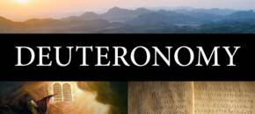
Southeast Georgia
School of the Bible
Lesson 5

Slide 9
Deuteronomy
The Book
Of
Remembrance

Slide 10
The Book of Deuteronomy
Author: Moses
Date: Written about 1405 B.C. – 40th year, 11th month (1:3)
Deuteronomy covers 1 month
at the end of the Wilderness Wanderings
The bulk of Deuteronomy consists of addresses spoken within the space of 40 days, beginning on the first day of the 11th month in the 40th year.

Slide 11
Deuteronomy
“2nd Giving of the Law”
The word comes from two Greek words, deuter, "second," and nomos, "law," the second law, or the repetition of the law. But when it review the law, it adds certain things not mentioned previously (Ch. 29:1).
Theme: REMEMBRANCE
Key Verse:
Deuteronomy 15:15
And thou shalt remember that thou wast a bondman in the land of Egypt, and the LORD thy God redeemed thee: therefore I command thee this thing to day.

Slide 12
Pivotal Passage
Deuteronomy 6:4-5
Hear, O Israel: The LORD our God is one LORD: And thou shalt love the LORD thy God with all thine heart, and with all thy soul, and with all thy might.
Notes:
58

Slide 13
Outline of Deuteronomy
I. Moses Looks Back
  Historical - Ch. 1-4
Times of Unbelief, Journeyings, & Victories
11 Days
Deuteronomy 1:2
(There are eleven days' journey from Horeb … unto Kadesh-barnea.)
40 Years
Numbers 14:34
After the number of the days in which ye searched the land, even forty days, each day for a year, shall ye bear your iniquities, even forty years, and ye shall know my breach of promise.
“It’s a little wayS over but a long way back”

Slide 14
Outline of Deuteronomy
II. Moses Looks Within
  Practical - Ch. 5-26
    Testimonies (5-11)
    Statutes (12-18)
    Judgments (19-26)
Deuteronomy 7:9
Know therefore that the LORD thy God, he is God, the faithful God, which keepeth covenant and mercy with them that love him and keep his commandments to a thousand generations;
Never Forget the Faithfulness of Our God and…
1-The Compassion of the Lord
2-The Commandments of the Lord
3-The Covenant of the Lord
4-The Consequences of Sin

Slide 15
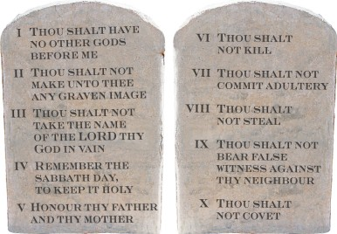
Outline of Deuteronomy
  III. Moses Looks Ahead
  Prophetical - Ch. 27-30
    Blessings & Curses
    Repentance & Return
    IV. Moses Looks Up
  Personal - Ch. 31-34
    New Leader
    New Song
    New Blessing
    New Home
10 Commandments
repeated
Ch. 5:6-21

Slide 16
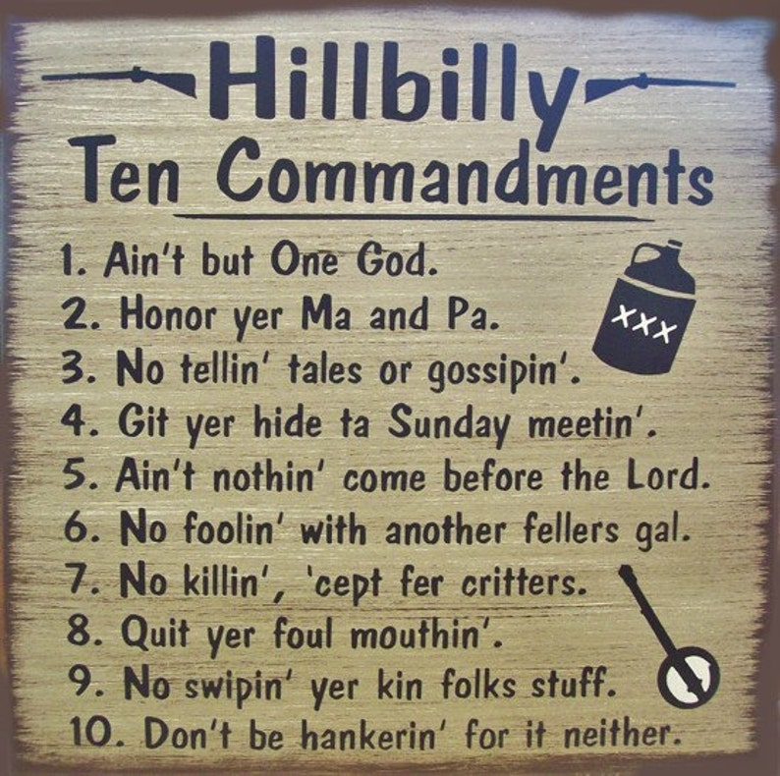

Slide 17
KEY WORDS
Remember / Obey
Observe / Keep
KEY PASSAGES
“The Everlasting Arms” (33:27)
The Death of Moses (Ch. 34)
“Mount Pisgah” in “Sweet Hour of Prayer” is Mount Nebo in Jordan, the place where Moses died, and the Lord buried him.
Notes:
58

Slide 18
Sweet hour of prayer! sweet hour of prayer!
May I thy consolation share,
Till, from Mount Pisgah’s lofty height,
I view my home and take my flight:
This robe of flesh I’ll drop and rise
To seize the everlasting prize;
And shout, while passing through the air,
Farewell, farewell, sweet hour of prayer!

Slide 19
Christ In The Book
Deuteronomy 32:31
“For their rock is not as our Rock...”
1 Corinthians 10:4
“And did all drink the same spiritual drink: for they drank of that spiritual Rock that followed them: and that Rock was Christ.”
Notes:
58

Slide 20
Deuteronomy 21:23
His body shall not remain all night upon the tree, but thou shalt in any wise bury him that day; (for he that is hanged is accursed of God;)...
Galatians 3:13
Christ hath redeemed us from the curse of the law, being made a curse for us: for it is written, Cursed is every one that hangeth on a tree:
(A picture of the curse Jesus took upon himself
as He hung on the cross for us.)

Slide 21
Deuteronomy 10:17
For the LORD your God is God of gods, and Lord of lords, a great God, a mighty, and a terrible, which regardeth not persons, nor taketh reward:
1 Timothy 6:15
Which in his times e shall shew, who is the blessed and only Potentate, the King of kings, and Lord of lords;
Revelation 19:16
And he hath on his vesture and on his thigh a name written, KING OF KINGS, AND LORD OF LORDS.

Slide 22
Key Verse
Deuteronomy 15:15
And thou shalt remember that thou wast a bondman in the land of Egypt, and the LORD thy God redeemed thee: therefore I command thee this thing to day.

Slide 23
Deuteronomy
The Book
Of
Remembrance

Slide 24
End of Lesson 5

