Slide 1
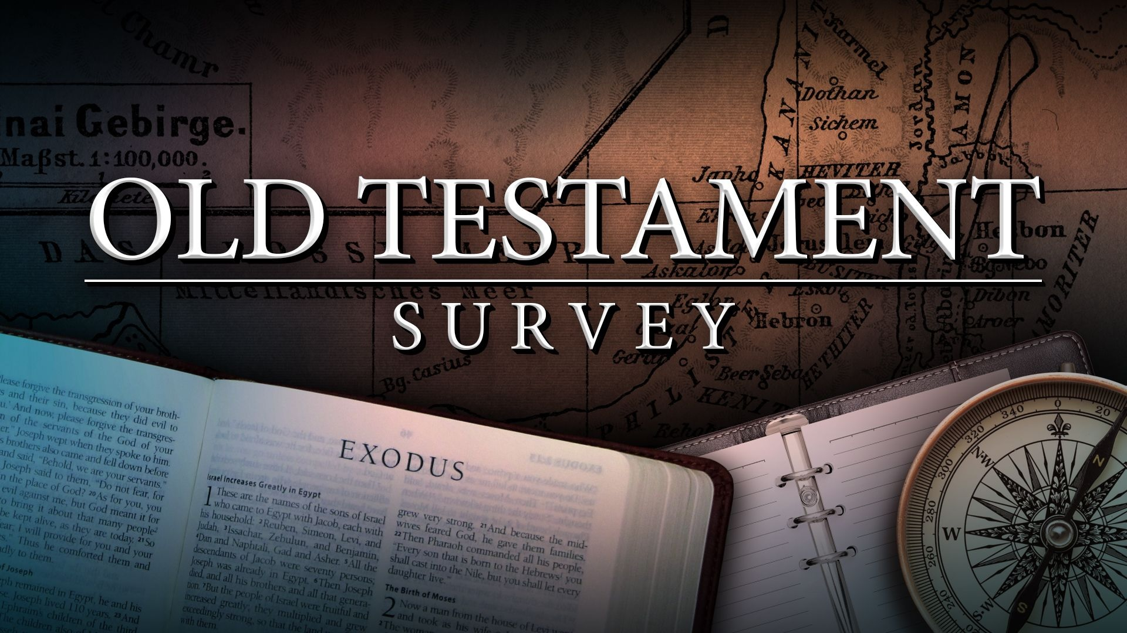
Southeast Georgia
School of the Bible
Lesson 6

Slide 2
Genesis
The Book of Beginnings
Four Great Events - 4 C’s
Creation/Curse/Catastrophe/Coalition
Four Great Men Abraham/Isaac/Jacob/Joseph
Genesis 1:1
“In the beginning God created the heaven and the earth.”

Slide 3
Exodus
The Book of Redemption
Exodus 6:6
Wherefore say unto the children of Israel, I am the LORD, and I will bring you out from under the burdens of the Egyptians, and I will rid you out of their bondage, and I will redeem you with a stretched out arm, and with great judgments:

Slide 4
Leviticus
The Book of Atonement
5 Major Offerings
“B-M-P-S-T”
Burnt – Redemption
Meat – Propitiation
Peace – Reconciliation
Sin – Justification
Trespass – Regeneration
Leviticus 16:34
And this shall be an everlasting statute unto you, to make an atonement for the children of Israel for all their sins once a year. And he did as the LORD commanded Moses.
7 Major Feasts
“P-U-F-P-T-A-T”
  1-Passover
  2-Unleavened Bread
  3-Firstfruits
  4-Pentecost
  5-Trumpets
  6-Atonement
  7-Tabernacles

Slide 5
Numbers
The Book of Wanderings
Numbers 33:1
These are the journeys of the children of Israel, which went forth out of the land of Egypt with their armies under the hand of Moses and Aaron.
"Numbering" of the people
Men Numbered - 20 yrs. old & above
Not Numbered - Levites, women, & children under 20 yrs. old

Slide 6
Deuteronomy
The Book of Remembrance
Deuteronomy 15:15
And thou shalt remember that thou wast a bondman in the land of Egypt, and the LORD thy God redeemed thee: therefore I command thee this thing to day.
Pivotal Passage
Deuteronomy 6:4-5
Hear, O Israel: The LORD our God is one LORD: And thou shalt love the LORD thy God with all thine heart, and with all thy soul, and with all thy might.

Slide 7
5 Books of Moses
The Law
The Torah
The Pentateuch

Slide 8
Southeast Georgia
School of the Bible
Lesson 6

Slide 9
Joshua
The Book
of
Victory

Slide 10
The Book of Joshua
Author: Joshua
Date: Written about 1404-1390 B.C.
3 Periods of time covered...
1) 1 Month @ Jordan
2) 7 Years @ Canaan
3) 8 Years divided on either side of Jordan
Theme: Possessing Your Possessions

Slide 11
Key Verse:
Joshua 1:8
This book of the law shall not depart out of thy mouth; but thou shalt meditate therein day and night, that thou mayest observe to do according to all that is written therein: for then thou shalt make thy way prosperous, and then thou shalt have good success.

Slide 12
Key Chapter Content

Slide 13
Outline of Joshua
I. ENTERING The Land - Ch. 1-5
II. OVERCOMING The Land- Ch. 6-13
III. OCCUPYING The Land - Ch. 13-24

Slide 14
Christ In The Book

Slide 15
Judges
The Book
of
Apostasy, Defeat,
& Deliverance

Slide 16
The Book of Judges
Author: Samuel
Date: Written c. 1043-1004 B.C. Judges covers about 350-400 years.
Judges is a sad contrast to the book of Joshua which records the blessings God bestowed on the Israelites for their obedience in conquering the land.
In Judges, they were disobedient and idolatrous, leading to many defeats. Yet God has never failed to open His arms in love to His people whenever they repented from their wicked ways and called upon His name. (Judges 2:18)
Theme: Failure Through Disobedience

Slide 17
The Book of Judges
Key Verse:
Judges 17:6
In those days there was no king in Israel, but every man did that which was right in his own eyes.

Slide 18
The Book of Judges
Apathy in one generation (ch. 1)
led to Apostasy in the next generation (ch. 2)
Two Great Truths are evident in Judges:
The Recurring Sinfulness of Man
The Persistent Mercifulness of God
The book begins with Disobedience (ch. 1) and
ends in Chaos & Confusion (see Ch. 21:25)

Slide 19
The Book of Judges
God's Repeated Dealings with Israel Reveals a Cycle of:
REST
REBELLION
RETRIBUTION
REPENTANCE
RESTORATION

Slide 20
The Judges
1. Othniel
2. Ehud
3. Shamgar
4. Deborah
5. Barak
6. Gideon
7. Tola
8. Jair
9. Jephthah
10. Ibzan
11. Elon
12. Abdon
13. Samson
13 Judges are mentioned in the book itself, 4 more are named in 1st Samuel.
In Judges, there are:
7 Apostasies
7 Servitudes
7 Deliverances
In Judges, the oppressors were the:
Mesopotamians Moabites
Philistines Canaanites
Ammonites Midianites

Slide 21
In Judges, whereas the nation fails, God still brings deliverance and salvation. The Lord is often seen to act by the most insignificant and ordinary means. The "little" instruments which He uses include:
1. A left hand and a dagger (Judges 3:15,16). (EHUD)
2. An ox-goad (Judges 3:31). (SHAMGAR)
3. A tent-peg (Judges 4:21,22). (JAEL)
4. A woman (Judges 5:7). (DEBORAH)
5. 300 men with pitchers and lamps (Judges 7:6-16). (GIDEON)
6. A woman and a stone (Judges 9:53). (A CERTAIN WOMAN)
7. A social outcast (Judges 11:2,3). (JEPHTHAH )
8. The jawbone of an ass (Judges 15:16). (SAMSON)
9. 300 foxes with firebrands (Judges 15:4). (SAMSON)

Slide 22
Christ In The Book
1. Every judge was a “Deliverer”
2. Christ is the Deliverer From Sin
3. Some Judges were:
Rulers / Warriors / “Kings”
Prophets
Priests
4. Christ is Prophet, Priest, and King

Slide 23
End of Lesson 6

Slide 26
End of Lesson 7

