Slide 1
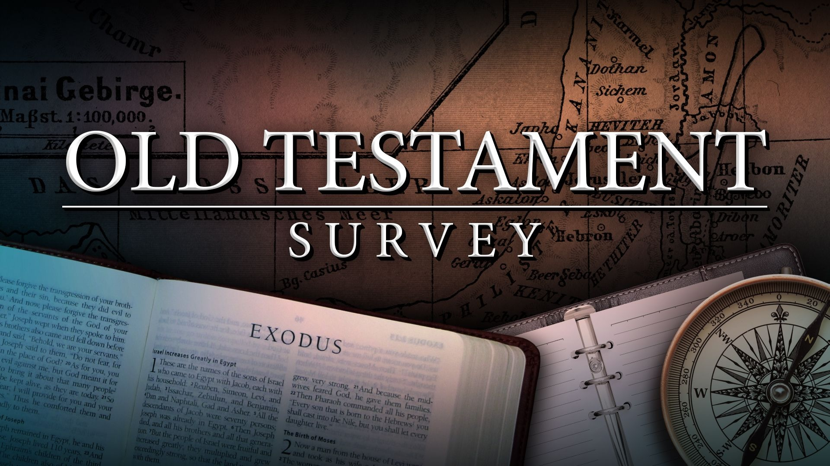
Southeast Georgia
School of the Bible
Lesson 9

Slide 2
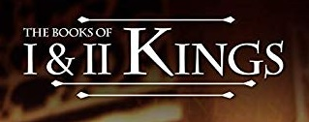
Lesson 9

Slide 3
Handout #9
1 & 2 Kings
The Book of 1 Kings
Author:
Most likely, Jeremiah, “The weeping prophet”
1 and 2 Kings were originally one book in the Hebrew Old Testament
Date:
Written about 586 B.C.
Covers a time period of 120 years:
→ 40 year reign of Solomon
→ 80 Years of Israel and Judah as separate kingdoms
Theme: “DISOBEDIENCE BRINGS DIVISION”
Solomon’s divided heart eventually resulted in a divided kingdom. [1 Kings 3:3, Compare to 1 Kings 11:1]
Solomon led Israel to the zenith of its size and glory, yet sin destroyed it all. [1 Kings 11:6-12]
Outline:
The Forty Years’ Reign of Solomon [Ch. 1-1 1]
The First Eighty Years of the Two Kingdoms [Ch. 12-22]

Slide 4
Handout #9
1 & 2 Kings
The Book of 1 Kings
Key Word: Loyalty
Key Verse: 1 Kings 2: 12 - “Then sat Solomon upon the throne of David his father; and his kingdom
was established greatly.”
Special Features:
The Divided Kingdom [Ch. 12]
  Israel
→ Northern kingdom — 10 tribes
→ First King: Jeroboam
→ Capital city: Samaria
  Judah
→ Southern kingdom — 2 tribes (Judah/Benjamin)
→ First King: Rehoboam (Solomon’s son)
→ Capital city: Jerusalem
The Conflict on Mt. Carmel [Ch. 18]
  Elijah the prophet of God faces the prophets of Baal
Christ In The Book
Solomon the King
  Christ’s glory and splendor is greater than that of Solomon’s [Matthew 12:42]
Elijah — (Matthew 16: 14)
  In his prophetic words and miraculous works he was a type of Christ

Slide 5
Handout #9
1 & 2 Kings
The Book of 2 Kings
Author:
Most likely, Jeremiah... Jeremiah ministered before and up to the captivity of Judah; he witnessed the destruction of Jerusalem firsthand.
Date:
Probably completed about 560 B.C.
Covers some 300 years, from the death of Ahab 853 B.C. to end of Jehoiachin’s days [555 B.C.]
Theme: “SIN ALWAYS LEADS TO CAPTIVITY”
In 1 Kings we ﬁnd division, in 2 Kings we find Israel and Judah each being led into captivity.
  Israel — taken by the Assyrians — 722 B.C. [Ch. 17]
  Judah — taken by the Babylonians — 586 B.C. [Ch. 25]
As the Jews continued away from God, they suffered more than division; they suffered
dispersion.
Outline:
The Annals of Israel, the Northern Kingdom [Ch. 1-10]
The Alternating Annals of both Kingdoms [Ch. 1 1-17]
The Annals of Judah, the Southern Kingdom [Ch. 18-25]

Slide 6
Handout #9
1 & 2 Kings
Division of the Kingdom
KEY THOUGHT: Disobedience Brings Division
Main Events
Solomon's Reign (40 years)
Building of the Temple
Division of Israel into Two Kingdoms
Chapter Content:
Northern Kingdom of Israel
Southern Kingdom of Judah
Chapter 1-4
Chapter 5-8
Chapter 9-11
Chapter 12-16
Chapter 17-18
Chapter 19
Chapter 20-22
Solomon Made King
The Building of the Temple
Solomon's Spiritual Decline
Kingdom Divided
Elijah's Obedience
Elijah's Discouragement
Ahab & Jezebel

Slide 7
Handout #9
1 & 2 Kings
The Book of 2 Kings
Key Words: “evil” — Again and again, the kings of Israel & Judah did evil in the sight of the Lord
Key Verse:
2 Kings 23: 27 - “And the LORD said, I will remove Judah also out of my sight, as I have removed Israel, and will cast off this city Jerusalem which I have chosen, and the house of which I said, My name shall be there.”
Special Features:
The 2 Captivities and their corresponding prophets:
→ Assyrian Captivity (Israel)
  Jonah, Amos, Hosea
→ Babylonian Captivity (Judah)
  Obadiah, Joel, Isaiah, Micah, Nahum, Habakkuk, Zephaniah, Jeremiah
These prophets ministered before or during the captivities
Christ In The Book:
Elisha is a type of Christ
  o He lived among his brethren
  o His ministry emphasized life, hope, and grace [Ch. 6-7, i.e]

Slide 12
Handout #9
1 & 2 Kings
Division of the Kingdom
Brief Summary - 1 Kings
The Book of 1 Kings starts with Solomon and ends with Elijah. The difference between the two gives you an idea as to what lies between. Solomon was born after a palace scandal between David and Bathsheba. Like his father, he had a weakness for women that would bring him down. Solomon did well at first, praying for wisdom and building a temple to God that took seven years. But then he spent 13 years building a palace for himself. His accumulation of many wives led him to worship their idols and led him away from God. After Solomon’s death, Israel became a divided kingdom and was ruled by a series of kings, most of whom were evil and idolatrous.
This, in turn, led the nation away from God and even the preaching of Elijah could not bring them back. Among the most evil kings was Ahab and his queen, Jezebel, who brought the worship of Baal to new heights in Israel. Elijah tried to turn the Israelites back to the worship of Jehovah, even challenging the idolatrous priests of Baal to a showdown with God on Mount Carmel. Of course God won the contest. This made Queen Jezebel angry (to say the least). She ordered Elijah's death so he ran away and hid in the wilderness. Depressed and exhausted, he said; "Let me die." But God sent food and encouragement to the prophet and whispered to him in a "still small voice," and in the process saved his life for further work.

Slide 13
Handout #9
1 & 2 Kings
Ministry of Elijah
Cp. James 5:16-18
Elijah is mentioned by New Testament writers more than any other Old Testament personality. His name occurs nine times in Matthew, nine times in Mark, eight times in Luke, twice in John, and once in Romans and James. When you consider the life of Elijah of Elijah, there is much about a his life that instructs and inspires.
REGULAR MAN
It is easy for us to read our Bible and place the great saints of the Scriptures on a high and lofty pedestal. We tend to put them into categories reserved for a select few. We see them as giants among men, and in a sense they are. Yet, we must not forget they were only men -- human beings like you and me. Nothing more and nothing less.
Elijah was one of the most honored and revered prophets to the Jewish people. He has been called, "the grandest and most romantic character Israel ever produced." There were numerous traditions that grew up around Elijah and exaggerated opinions developed, ascribing him super-human traits. Yet, as James draws our attention to him he reminds us that he was just a regular, ordinary man. before he tells of what Elijah accomplished through prayer, he reminds us that Elijah was a man just like each one of us. We read in verse 17, "Elias was a man subject to like passions as we are."
Elijah had the same nature that each of us has. You could say, "Elijah put his pants on just like we do, one leg at a time." The word translated "subject to like passions" simply means, "to be similarly affected." One writer speaking of the statement wrote: "Elijah was subject to the same human emotion and liable to the same weaknesses that we all have." Another translator rendered the words, "with feeling just like ours."
We have the same thought in Acts 14 when Paul preached at Iconium. When he performed miracles the people began to cry out, "The gods are come down to us in the likeness of men" (Acts 14:1). The response of Paul and Barnabas was, "We also are men of like passions with you" (Acts 14:15). Paul was saying, "We are not gods. We are only human beings like each of you."
In case you think that your praying could never be effective and prevailing as Elijah, remember he was just a human being like you. Elijah was a great man, but he was just a man. James reminds us of the humanity of Elijah to disarm our feelings that we could never get answers to prayer as did he. The emphasis on his likeness to all of us in an encouragement that we are praying to the same God that Elijah prayed and that God can answer our prayers as He did Elijah's. Furthermore, we not only see him a regular man, but also as a:
RIGHTEOUS MAN
In verse 16 tells us that mighty prevailing prayer is the result of a "righteous man." Elijah may be been just a man, yet there was mark of holiness and righteousness about his life. He was a man wholly

Slide 14
Handout #9
1 & 2 Kings
devoted to God. Oftentimes Elijah is addressed as "a man of God." He was a man committed and consecrated to God. The people of his day saw him and knew him to be a man that belonged to God.
I think of 2 Kings 1:10 where we read, "And Elijah answered and said to the captain of the fifty, If I be a man of God, then let fire come down from heaven, and consume thee and thy fifty. And there came down fire from heaven, and consumed him and his fifty." Elijah conditioned the answering of his prayer on the matter of he being a man of God or a righteous man.
God answered his prayer. If we are to prevail in prayer we must as well be righteous. What does it mean to be righteous? The word describes someone who by implication is "innocent or holy." To be righteous is simply to be right with God! To prevail with God in prayer we must be clean before God. There can be no unconfessed sin in our heart. To get an audience with God requires that we be right.
The Psalmist was very straight forward when he stated: "If I regard iniquity in my heart, the Lord will not hear me" (Psalm 66:18). Nothing could said any plainer. If I have something in my heart that is not right, the Lord will not hear my prayers. If He cannot hear me, I will never get an answer.
I read about a Sunday School class of young girls that wrote missionaries to tell them they had been praying for them. The teacher told them that the missionaries were busy and not to expect them to answer their letter. One little girl wrote: "We have been praying for you. We are not expecting an answer."
When it comes to unconfessed sin in our life, there is no use to expect an answer. Mighty prevailing prayer is prayer offered from the heart of someone that is righteous. The second thing about prayer that I want you to see in Elijah is:

Slide 15
Handout #9
1 & 2 Kings
The Book of 2 Kings
Dispersion of the Kingdom
KEY THOUGHT: Willful Sin Brings a Woeful End
History of the Divided Kingdoms
Covers the time period of the Minor Prophets (Hosea-Malachi)
Main Events
Captivities of each kingdom
Elijah's Translation & Ministry
Naaman's Healing
Chapter Content:
Chapter 1-4
Chapter 5
Chapter 6-8
Chapter 9-10
Chapter 11-16
Chapter 17
Chapter 18-20
Chapter 21-24
Elijah's Ministry Begins Healing of Naaman Miracles of Elisha Reign of Jehu
The Thirteen Kings The Downfall of Israel Hezekiah's Reign
Manasseh, Josiah, and the Downfall of Judah
Brief Summary - 2 Kings
2 Kings depicts the downfall of the divided kingdom. Prophets continue to warn the people that the judgment of God is at hand, but they will not repent. The kingdom of Israel is repeatedly ruled by wicked kings, and even though a few of Judah's kings are good, the majority of them lead the people away from worship of Jehovah. These few good rulers, along with Elisha and other prophets, cannot stop the nation's decline. The Northern Kingdom of Israel is eventually destroyed by the Assyrians, and about 136 years later the Southern Kingdom of Judah is destroyed by the Babylonians. There are three prominent themes present in the Book of 2 Kings.
First, the Lord will judge His people when they disobey and turn their backs on Him. The Israelite’s unfaithfulness was reflected in the evil idolatry of the kings and resulted in God exercising His righteous wrath against their rebellion.
Second, the word of the true prophets of God always comes to pass. Because the Lord always keeps His word, so too are the words of His prophets always true.

Slide 16
Handout #9
1 & 2 Kings
Third, the Lord is faithful. He remembered His promise to David (2 Samuel 7:10-13), and, despite the disobedience of the people and the evil kings who ruled them, the Lord did not bring David’s family to an end.
Ministry of Elisha
HIS CALL
His Preparation
His Parting Gift From Elijah
HIS CAREER
His Private Ministry His Public Ministry
Elijah & Elisha Compared
In 2 Kings 2, we have story of the translation of Elijah which also begins the ministry of Elisha. Both of these prophets had to minister in times of terrible national decay, and we can see, in moving from the ministry of Elijah to that of Elisha, a transition that took place in the history of Israel.
There is a change in prophets, we move from Elijah to Elisha.
There is a change in books, we move from 1 Kings to 2 Kings.
There is a change in kings, we go from Ahab to Ahaziah, his son.
The Two Prophets Compared
Though Elisha was the understudy of Elijah, these two prophets were very different in their ministries and in the way God used them.
Both were men of godly character and faith who stood firmly on the Word of God.
As we compare them we need to be reminded of the following truth: cf 1 Co. 3:4-9
Their Miracles Compared
A. The Miracles of Elijah
Declares a long drought (1 Kings 17:1)
Multiplies widow's flour and oil (1 Kings 17:7-16)
Resurrects widow's son (1 Kings 17:17-24)
Calls down fire from heaven (1 Kings 18:1-40)
Sends a rainstorm (1 Kings 18:41-45)
Outruns a chariot (1 Kings 18:46)
Predicts Ahaziah's death (2 Kings 1:1-2)
Ahaziah's men killed by fire from heaven (2 Kg. 1:9-17)
Parts the Jordan River (2 Kings 2:1-8)
B. The Miracles of Elisha
Parts the Jordan River (2 Kings 2:13-14)
Makes Jericho spring drinkable (2 Kings 2:19-22)
Sends bears to punish rude youths (2 Kings 2:23-25)
Floods ditches to confuse Moabites (2 Kings 3:1-27)
Multiplies widow's oil (2 Kings 4:1-7)
Shunammite woman bears a son (2 Kings 4:8-17)
Resurrects Shunammite's son (2 Kings 4:18-37)
Purifies poisoned stew (2 Kings 4:38-44)
Heals Naaman's leprosy (2 Kings 5:1-14)
Gehazi struck with leprosy (2 Kings 5:15-27)
Floats lost axhead (2 Kings 6:1-7)
Gives special sight to the king's envoy (2 Kg. 6:16-17)
Blinds the Aramean army (2 Kings 6:8-23)
His bones resurrect a dead man (2 Kings 13:20-21)

Slide 17
Handout #9
1 & 2 Kings
Their Ministries Compared
Both prophets were similar in their overall purpose to resist the cult of Baal and to demonstrate by their miracles and ministry that the only true God is the God of Israel.
Elijah is noted for great public acts, while Elisha is distinguished by the large number of miracles he performed, many of them for individual needs.
Elijah's ministry emphasized God's law, judgment, and severity. Elisha supplemented this by demonstrating God's grace, love and tenderness.
Elijah was like John the Baptist, thundering the message of repentance for sin. Elisha followed this up by going about, as Christ did, doing deeds of kindness, and by doing miracles attesting that the words of the prophets were from God.
Both Men Cast Great Shadows Upon Their Land.
All of us are casting shadows as we go through this present life.
  Shadows always amazed me when I was a child. Explain: stepping on them, watching them change with our walk.
  We cannot control our shadows, but we are constantly casting them as we walk in the light.
  Our physical shadows remind us that we are also casting shadows of spiritual influence upon others.
  Just as our bodies cast their shadows quite involuntarily, so we are continually and quite involuntarily casting the shadow of our moral and spiritual influence upon other lives.
Our only choice is the kind of influence we have.
  We cannot choose to be non-influential anymore than we can choose not to cast shadow.
  But, we can determine what kind of influence our lives will be.
  Our influence may contribute either to the eternal salvation or the eternal damnation of others.
  To the spiritual edification or the spiritual hurt of others.
(Gal 6:7-8) "Be not deceived; God is not mocked: for whatsoever a man soweth, that shall he also reap. {8} For he that soweth to his flesh shall of the flesh reap corruption; but he that soweth to the Spirit shall of the Spirit reap life everlasting."
One of the things we sow is an influence.
  We may think our influence is very small.
  We may think that this doesn't necessarily apply to us, but that is simply not true.
  We will have an impact on this world, the question before us is what kind of influence will it be?
Although their ministries were different, both were called of God to serve in the capacity of a prophet.

Slide 18
Handout #9
1 & 2 Kings
Israel - The Divided Kingdom
Kings of Israel… ALL BAD
1. | Jeroboam I |  |  |  |  |  |  |  | rebellious | 1 Kings 11:28
2. | Nadab |  |  |  |  |  |  |  | bad | 1 Kings 14:20
3. | Baasha |  |  |  |  |  |  |  | wicked | 1 Kings 15:16
4. | Elah |  |  |  |  |  |  |  | evil | 1 Kings 16:8
5. | Zimri |  |  |  |  |  |  |  | sinful | 1 Kings 16:15
6. | Omri (overlap with Tibni) |  |  |  |  |  |  |  | extra bad | 1 Kings 16:16
7. | Ahab |  |  |  |  |  |  |  | the worst to that point | 1 Kings 16:29
8. | Ahaziah |  |  |  |  |  |  |  | disobedient | 1 Kings 22:40
9. | Joram/Jehoram |  |  |  |  |  |  |  | mostly rotten | 2 Kings 1:17
10. | Jehu |  |  |  |  |  |  |  | not good but better than the rest | 1 Kings 19:16
11. | Jehoahaz |  |  |  |  |  |  |  | noncompliant | 2 Kings 10:35
12. | Joash |  |  |  |  |  |  |  | wayward | 2 Kings 13:10
13. | Jeroboam II (overlap) |  |  |  |  |  |  |  | badly behaved | 2 Kings 14:23
14. | Zechariah |  |  |  |  |  |  |  | abysmal | 2 Kings 14:29
15. | Shallum |  |  |  |  |  |  |  | full of vice | 2 Kings 15:10
16. | Menahem |  |  |  |  |  |  |  | horrible | 2 Kings 15:14
17. | Pekahiah |  |  |  |  |  |  |  | idolatrous | 2 Kings 15:23
18. | Pekah (overlap) |  |  |  |  |  |  |  | awful | 2 Kings 15:25
19. | Hoshea |  |  |  |  |  |  |  | appalling | 2 Kings 15:30
Kings of Judah… MOST BAD
Rehoboam
Abijah
mostly bad
1 Kings 11:43
1 Kings 14:31
Asa
Jehoshaphat (overlap)
mostly perverted
1 Kings 15:8
1 Kings 15:24
good
5. Jehoram/Joram (overlap)
righteous
2 Chronicles 21:1
6. Ahaziah
terrible
Athaliah (queen)
Joash/Jehoash
bad
2 Kings 8:25
devilish
2 Kings 8:26
2 Kings 11:2
Amaziah
Uzziah/Azariah (overlap)
mostly virtuous
2 Kings 14:1
2 Kings 14:21
mostly wholesome
11. Jotham (overlap)
mostly respectable
2 Kings 15:5
2 Kings 15:38
12. Ahaz
worthy
13. Hezekiah
heinous
the best
2 Kings 16:20
14. Manasseh
depraved until he repented at the end
2 Kings 21:1
2 Kings 21:19
15. Amon
treacherous
Kings 13:2
Kings 23:30
16. Josiah
great
17. Jehoahaz
dreadful
2 Kings 23:34
2 Kings 24:6
18. Jehoiakim
degenerate
19. Jehoiachin
frightful
20. Zedekiah
foolish
2 Kings 24:17
Highlighted Kings are to be memorized

Slide 19
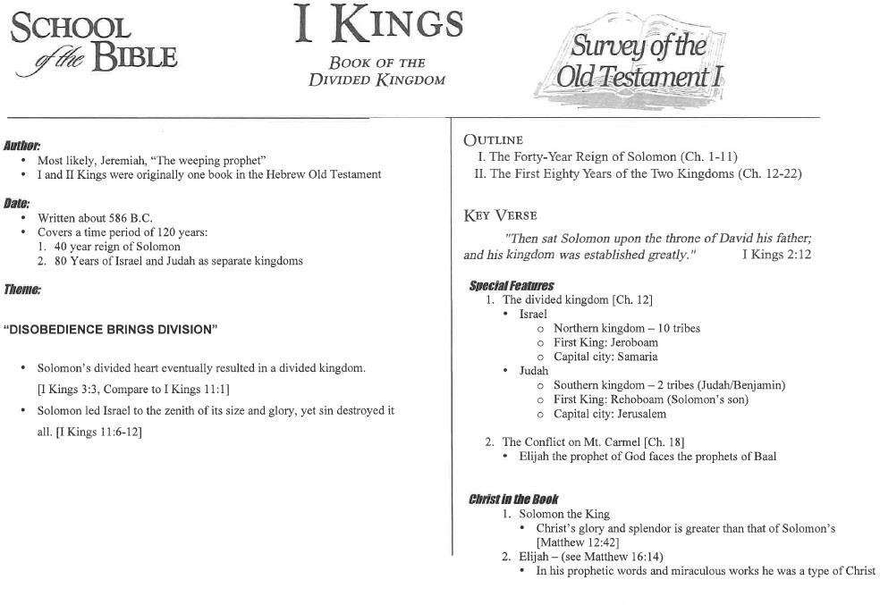
Handout #9
1 & 2 Kings

Slide 20
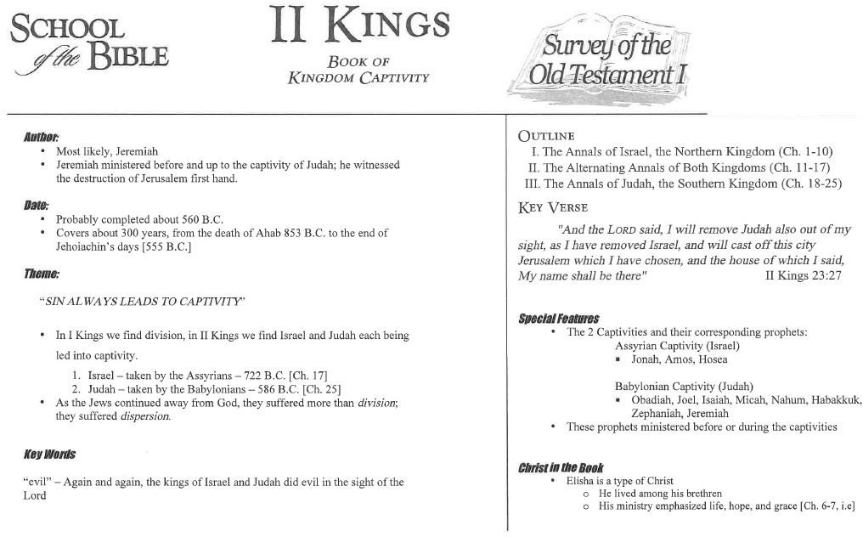
Handout #9
1 & 2 Kings

