Slide 1
Southeast Georgia School of the Bible
Lesson 14
Psalms & Proverbs

Slide 2
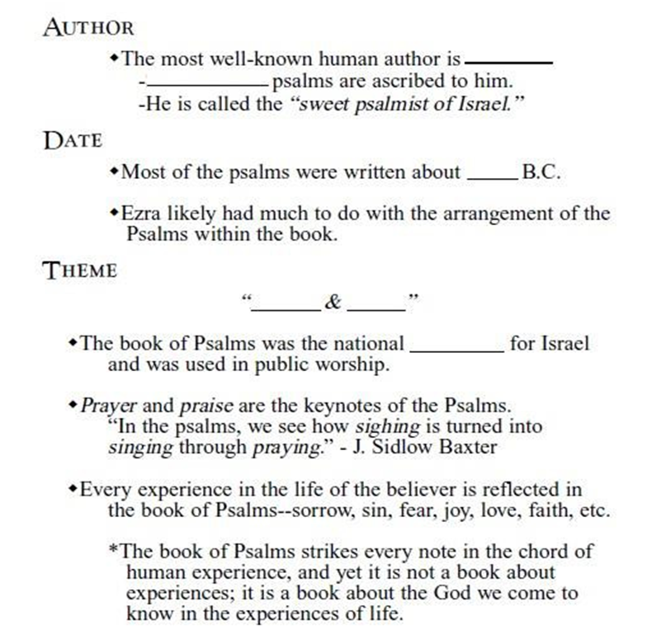
Psalms
David
73
1,000
Prayer
Praise
Hymnbook

Slide 3
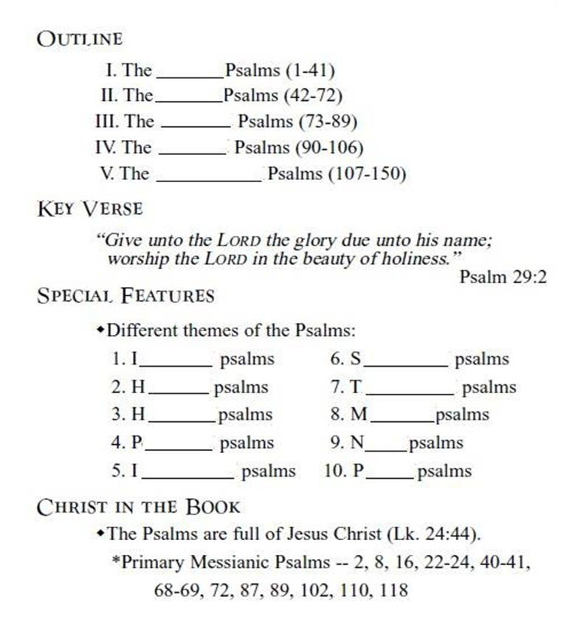
Psalms
Genesis
Exodus
Leviticus.
Numbers
Deuteronomy
Instructive
Supplication
Historical
Thanksgiving
Hallelujah
Messianic
Penitential
Nature
Imprecatory
Pilgrim

Slide 4
Proverbs
“pro”-for
“verbs”-words
Words for a Given Situation
Solomon
3,000
950-900
Laws
Earth
divine
Statement
Structure

Slide 5
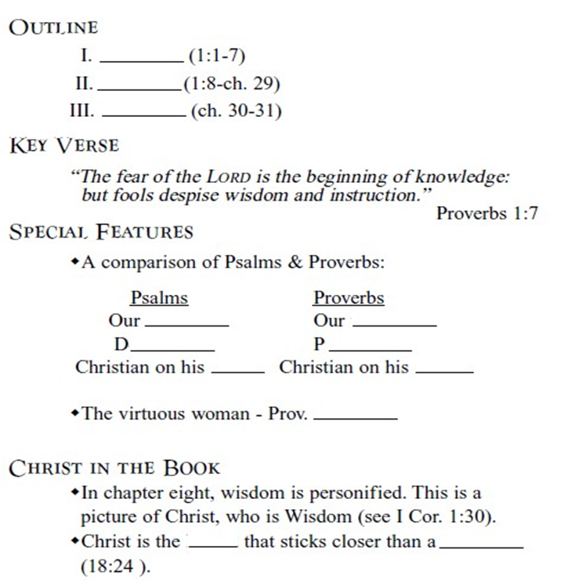
Proverbs
“pro”-for
“verbs”-words
Words for a Given Situation
PROLOGUE
MAXIMS
EPILOGUE
Worship
Walk
Devotional
Practical
Knees
Feet
31:10-31
Friend
brother

Slide 6
Four Types of People in Proverbs
There are four types of people represented in the book of Proverbs.
The _WISE__ (Prov. 3:13)
The __SIMPLE___ (Prov. 22:3)
The _FOOL_ (Prov. 12:15)
The __SCORNER__ (Prov. 13:1; 22:10)
The Scripture gives instructions on how to deal with each of these problem attitudes.
4 Types of People in Proverbs
WISE
SIMPLE
FOOL
SCORNER

Slide 7
The People of Proverbs:
WISE
SIMPLE
FOOL
SCORNER
The goal of Proverbs is for Solomon to help his son find wisdom and avoid the way of a fool. In between the WISE and the FOOL is the… SIMPLE.
The Biblical Description of the “Simple”
He lacks ____judgment ____
(Prov. 7:7}.
He believes ___anything ___ (Prov. 14:15).
He stumbles through life without regard for ___consequences ___ (Prov. 22:3).
He drifts into the path of __fools __ and _mockers _ (Prov. 22:3).
We must acquire wisdom or remain a “simpleton”.

Slide 8
