Slide 1
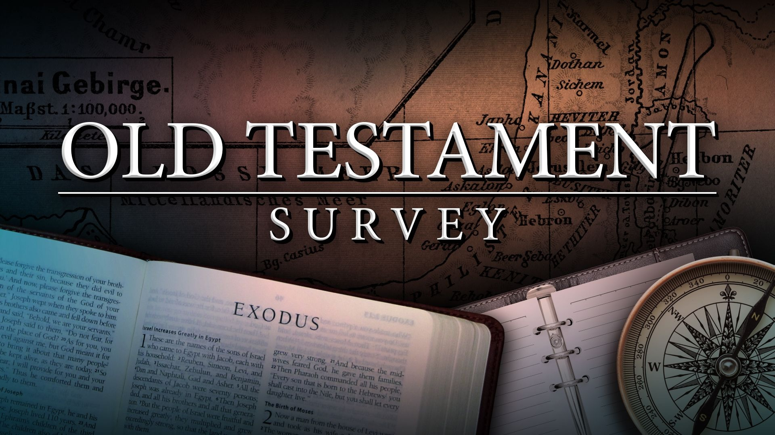
Southeast Georgia
School of the Bible
Lesson 7
The Book of Ruth

Slide 2


Slide 3
Ruth
The Book
of
Redeeming Grace
~The Book of Romance~

Slide 4
The Book of Ruth
The beautiful romance of Ruth is set against the dark background during the apostasy and oppression of the period of the Judges.
Because of a local famine, Elimelech (= my God is King)
took his wife Naomi (= pleasant, lovely) and his two sons, appropriately named Mahlon (“puny”) and Chilion (“pining”), to visit temporarily in nearby Moab.
Moab was about 50 mi. from Bethlehem on the east side of the Dead Sea. Moab was the son of Lot by an incestuous union with his older daughter.(Gen. 19:31-38).
Ephrathites. The inhabitants of Bethlehem (1 Sam. 17:12).

Slide 5
The Book of Ruth
How Ruth Was Sought… by the Lord
How Ruth Was Taught … by Naomi
How Ruth Was Bought… by Boaz

Slide 6
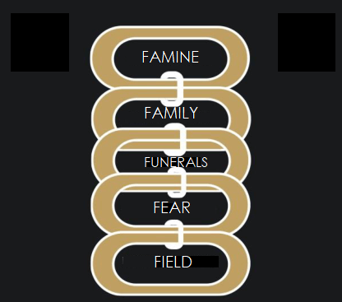
Links in the Chain of Ruth’s Redemption
In Judah
of Elimelech & Naomi
3 Funerals:
Elimelech
Chilion
Mahlon
3 Widows:
Naomi-Grieving
Orpah-Leaving
Ruth-Cleaving
Orpah & Ruth
of Boaz

Slide 7
The Book of Ruth
Author - Probably Samuel the prophet
Ruth 1:1 indicates that it was written after the time of Judges looking back…
Ruth 1:1
Now it came to pass in the days when the judges ruled, that there was a famine in the land. And a certain man of Beth-lehem-judah went to sojourn in the country of Moab, he, and his wife, and his two sons.
Date - The events of this book cover a period of 10-12 years during the time of the judges (approx. 1300 B.C.)
Theme - “REDEEMING GRACE”

Slide 8
The Book of Ruth
This is a beautiful story of God’s redeeming grace in the life of a family. The story centers around the role of the KINSMAN—REDEEMER
— one who redeems —
Three Qualifications of a Kinsman-Redeemer: (Lev. 25, Num. 35)
1. He must have the right to redeem by Relationship (2:1, 3, 9)
2. He must have the Power to redeem (3:11, 4:9)
3. He must be Willing to redeem (3:13)
*We can know God’s redeeming grace through Jesus Christ,
who meets all these qualifications!

Slide 9
HOW FAR CAN YOU GO ON GRACE? ...
Out of Moab
Into the house of bread (Bethlehem)
Into the harvest of Boaz,
Up to the table of fellowship,
Down to the threshing-floor,
And into the family!
...From being the wife of Mahlon to being a Woman in Messiah’s line!

Slide 10
The Book of Ruth
Outline:
I. Love’s Resolve (ch. 1)
* Ruth’s noble choice
II. Love’s Response (ch. 2)
* Ruth’s lowly service
III. Love’s Request (ch. 3)
* Ruth’s tender appeal
IV. Love’s Reward (ch. 4)
* Ruth’s marital joys
This is a love story
— it shows us that God’s redeeming grace is not extended out of duty, but out of His great love for us.

Slide 11
The Book of Ruth
Key Words:
“redeem”
“kinsman”
Key Verse:
Ruth 4:14
And the women said unto Naomi, Blessed be the LORD, which hath not left thee this day without a kinsman, that his name may be famous in Israel.

Slide 12
Special Features:
Lessons learned from this story . . .
1. Elimelech — Refused to come back to God
2. Naomi — Returned to the will of God
3. Mahlon/Chilion — Reaped what their father had sown
4. Orpah — Rejected the true God
5. Ruth — Received salvation and all its benefits

Slide 13
Christ In The Book
Boaz (“in him is strength”) is a picture of Christ:
1. He is the one who shows grace to strangers. (2:10)
2. He paid the redemption price in full.
3. He did what the nearer kinsman would not & could not do.
4. He is the Lord of the harvest.
5. He is the Bridegroom.
6. He took a Gentile bride.
7. He is the famous one from Bethlehem. (4:1, 14)

Slide 14
End of Lesson 7

