Slide 1
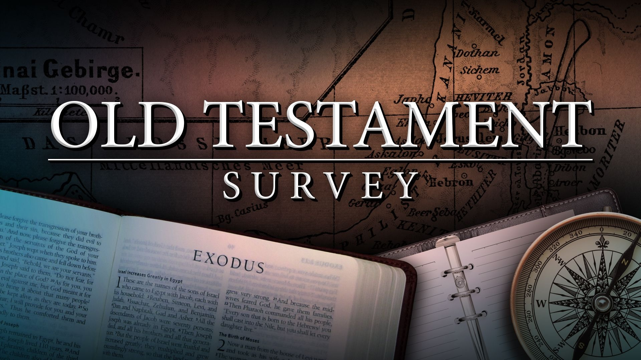
Southeast Georgia
School of the Bible
Lesson 8

Slide 2

Lesson 8

Slide 3
1st Samuel
The Book
of
Rejection
(Israel’s 1st King – Saul)

Slide 4
The Book of 1st Samuel
Author: (Probably several)
Samuel — “asked of God”
Nathan, Gad, and others in the school of the prophets(1 Chron. 29:29)
Date: Events cover 115 years—from the birth of Samuel to Saul’s death.
Compiled around 1000 B.C.
Theme:
“REJECTION’
From Theocracy to Monarchy
1. God rejects Eli and chooses Samuel. (1:11-14, 19-20)
2. The people reject God and choose a king. (8:7)
3. Saul rejects God and chooses self. (1318-14; 15-17)
4. God rejects Saul and chooses David. (15:23-26; 16:11-14)

Slide 5
Outline:
I. Samuel: Last of the Judges (Ch. 1-7)
II. Saul: First of the Kings (Ch. 7-15)
David: The Anointed Successor (Ch. 16-31)
Key Words: “kingdom”
Key Verse:
1 Samuel 8:7
“And the LORD said unto Samuel, Hearken unto the voice of the people in all that they say unto thee: for they have not rejected thee, but they have rejected me, that I should not reign over them. ”

Slide 6
The Story of 4 Men & 1 Woman:
Eli, the Failing High Priest
Samuel, the Last of the Judges
Saul, the First of the Kings
David, the Greatest of the Kings
1. Hannah:
Barren
Burdened
Broken
Blessed
“If we had more mothers like Hannah,
we would have more sons like Samuel.”

Slide 7
Special Features:
1. This book is a transition from...
Theocracy to Monarchy
Commonwealth of Judges to the Crown
2. The man Samuel is transitional:
He is last of the judges
He marks the institution of the monarchy
He marks the institution of the prophetic office (Acts 3:24; 13:20; Heb. 11:32) First of the prophets.
3. Lessons from Saul...
1-Natural abilities are a curse when not given to God.
a. Handsome (9:2) — Pride (18:28)
b. Initiative (1 1 :7) — Rebellion (20:31)
c. Bravery ( 13:3) — Recklessness (14:24)
2-Incomplete obedience is full disobedience
3-Jealously will destroy your life.

Slide 8
Christ In The Book:
The ministry of Samuel:
1) Prophet (2:27-35)
2) Priest (2:35)
3) Intercessor (7:5-8)
4) Judge (7:15-17)

Slide 9
2nd Samuel
The Book
of
Triumph & Trouble
(Israel’s 2nd King – David)

Slide 10
The Book of 2nd Samuel
Author: The Book of 2 Samuel does not identify its author. It could not be the Prophet Samuel, since he died in 1 Samuel. Possible writers include Nathan and Gad (see 1 Chronicles 29:29-The Writings of Nathan and Gad)
Originally, 1 and 2 Samuel were one book in the Hebrew O.T. - The book of Samuel
Date: The events of 1 Samuel span approximately 100 years, from c. 1100 B.C. to c. 1000 B.C. The events of 2 Samuel cover another 40 years. The date of writing, then, would be sometime after 960 B.C.
Theme:
“TRIUMPH AND TROUBLE”
Triumph turns to trouble through sin.
This book covers 40 years — The reign of David (5:4-5)
7 yr. 6 months — reigning in Hebron over Judah
33 years — reigning in Jerusalem over all Israel

Slide 11
1. Triumph is the result of FAITH.
Ch. 1-10 David knows no defeat, he is a man after God’s own heart.
2. Trouble is the result of SIN.
Ch. 11 — David experiences personal defeat, he is a man with a broken heart.
All sin, whether in the king or the peasant, brings bitter suffering.
Outline:
2 Samuel is the record of King David’s reign. This book places the Davidic Covenant in its historical context.
I. David’s Triumphs (Ch. 1-12)
II. David’s Troubles (Ch. 13-24)

Slide 12
Key Words:
“king” and “before the Lord”

Slide 13
Chapter Content:
Chapter 1-5
Chapter 6
Chapter 7
Chapter 8
Chapter 9-10
Chapter 11-14
Chapter 15-19
Chapter 20-23
Chapter 24
David Made King
David Brings the Ark Home
The Davidic Covenant
David’s Kingdom Established
The Lame Prince - Him
David’s Sin & Repentance
Absalom’s Rebellion
David’s Return to Jerusalem
David’s Sin in Numbering the People

Slide 14
Key Verse:
2 Samuel 5:4-5
“David was thirty years old When he began to reign, and he reigned forty years. In Hebron he reigned over Judah seven years and six months: and in Jerusalem he reigned thirty and three years over all Israel and Judah.”
Special Features:
Lessons learned from David’s sin:
1. Beware of the day of prosperity
2. Sin always leads to greater sin.
3. A fall Without is preceded by a fall Within.
4. Sin yields a harvest of horrible things.
5. One man’s sin affects a multitude of lives.
David is mentioned more than any other character in the Bible.
Psalm 51 reveals David’s broken and contrite heart over his sins.

Slide 15
David's Fourfold Judgment
And he shall restore the lamb fourfold, because he did this thing, and because he had no pity.
2 Samuel 12:6
1. The Baby Died
2. Tamar is Raped by Amnon
3. Amnon is Killed by Absalom
4. Absalom is Killed

Slide 16
Christ In The Book:
The promises of The Davidic Covenant to be fulfilled in the person of Christ. (Lk. 1:32-38)
2. David and Mephibosheth (Ch. 9)
A helpless cripple, an enemy by nature, is made a part of the king’s family… (Eph. 4:32— “for Christ’s sake”)
Mephibosheth - Kindness for Jonathan’s Sake
2 Samuel 9:1-13
This is perhaps the premier story and example of Old Testament grace. The fallen house of Saul receives mercy and grace from the triumphant house of David.

Slide 17

Mephibosheth was the son of Jonathan, who was the son of King Saul and a special friend of King David. When Mephibosheth was five years old, his father Jonathan was killed in battle. Fearing that the Philistines would seek to take the life of the young boy, a nurse fled with him to Gibeah, the royal residence, but in her haste, she dropped him, and both of his feet were crippled (2 Samuel 4:4).
We, like Mephibosheth, are crippled by a fall
—but God has a gift for us through Jesus Christ if we will accept Him.

Slide 18
Mephibosheth - Kindness for Jonathan’s Sake
I. David Sought for Him (“Any of the House of Saul”) (2 Sam. 9:1)
His covenant with Jonathan (1 Samuel 20:11-17)
II. David Searched for Him (2 Samuel 9:2-4)
He inquired of Ziba (2 Sam. 9:2-3) and Ziba led him to Him; “lame on his feet”
III. David Sent for Him (2 Samuel 9:5-6)
He fetched him out of Lo-debar (2 Sam.9:5; Psalm 40:2)
IV. David Showed Kindness to Him (2 Samuel 9:7-8)
For Jonathan’s sake (2 Sam. 9:7; Isaiah 53:4-6)

Slide 19
Mephibosheth - Kindness for Jonathan’s Sake
V. David Served Him (2 Samuel 9:9-12)
He appointed Ziba to serve him (2 Sam. 9:9-10)
VI. David Showered Blessings on Him (2 Samuel 9:10)
He gave him 70 feet to replace his lame ones – Ziba’s 15 sons and 20 servants
VII. David Secured a Place for Him (2 Samuel 9:13)
Dwelling in Jerusalem and eating continually at David’s table and still lame on both feet – still no merit!

Slide 20
Purpose of Writing
2 Samuel is the record of King David’s reign. This book places the Davidic Covenant in its historical context.
The Davidic Covenant
2 Samuel 7:4-17 This was given to David, through Nathan the Prophet, at Jerusalem.
It contains 3 promises.
1. A House. Vs. 13. This is the “house of David,” his posterity of David shall never be destroyed.
2. A Throne. Vs. 13. The Kingdom of David shall never be destroyed. Since the “Captivity” but one King of the Davidic family has been crowned and He with “thorns” (Matt 27:29).
3. A Kingdom. David’s Son is to have an earthly “sphere of rule.” It will be over the Millennial Earth.
The “Sign” of this Covenant is a Son. (Luke 1:30-33; 2:12).
This Covenant extends to the “End of Time.”

Slide 21
End of Lesson 8

